Slide 1

23IT301 WEB TECHNOLOGY USING REACT
Hotel Booking System
JOSHUA ARNOLD LEO (727823TUCS122)
MADUGULA PRAVEEN KUMAR (727823TUCS143)
KAVIYA H (727823TUCS30)
JAVID AFZAL S (727823TUCS118)

Slide 2
PROJECT DESCRIPTION
A Hotel Booking System is a comprehensive software application designed to simplify and enhance the various operations involved in managing hotel reservations.
The system allows hotel staff to efficiently manage room bookings, check-in and check-out processes, and track room availability in real time.
The system is tailored to provide a seamless experience for both hotel staff and guests, ensuring efficient operations and high customer satisfaction.

Slide 3

FEATURES AND ADVANTAGES:
Menu Management
Room Management
Customer Feedback
Report and Analytics

Slide 4
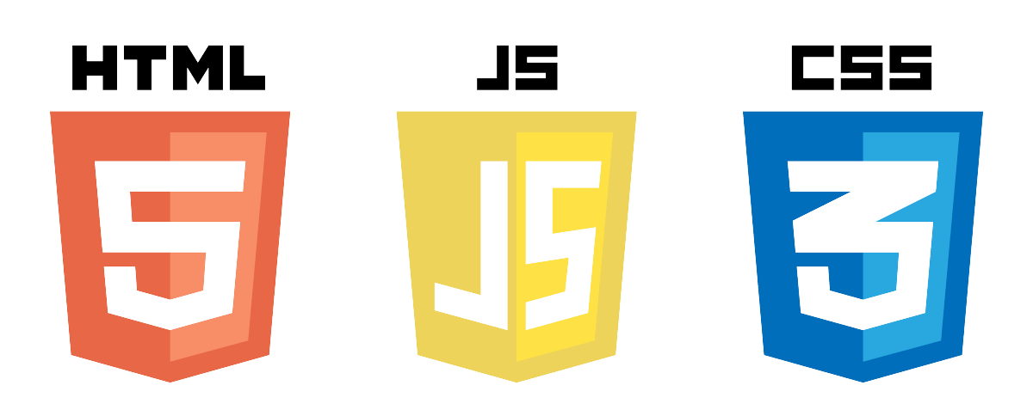
FRONT-END DEVELOPMENT
USER
ADMIN
Navbar
Login Page
Hotel Selection
Room Availability
Room Booking
Confirmation & Feedback
Navbar
Login Page
View Reviews
Add or Update Hotel Details

Slide 5
REQUIREMENTS
HARDWARE
SOFTWARE
Processor: i5 or More
RAM: 8GB or More
Storage: 10GB or more
Internet connection
Node.js: v14 or more
Web Browser: Chrome(Preferred)
Code Editor (VSCode, etc. ).
Additional Packages:
React, Component
React-router-dom

Slide 6
HMS APPROACH
HotelListing.js
LoginPage.js
BookingForm.js
HMS STORE
BookingConformation.js
RoomAvailability.js

Slide 7

OTHER Files
Review.js
Navbar.js
Contact.js
About.js
Homepage.js

Slide 8
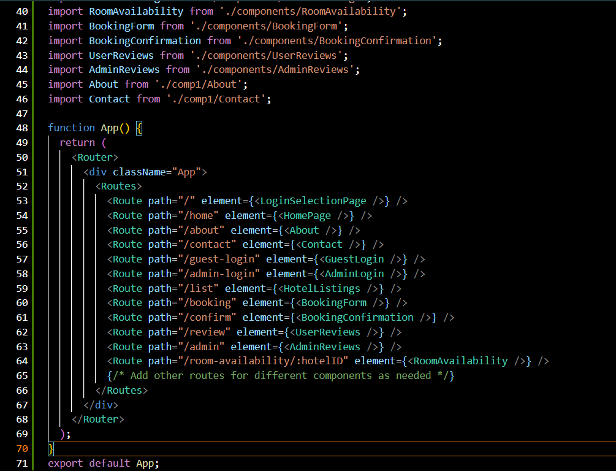
COMPONENTS USED:
App.js:
Router: A router is a component that determines which components should be rendered based on the current URL.
Routes: Routes define the mapping between the URL paths and the components that should be rendered when a user visits a particular path.
Available In: react-router-dom

Slide 9
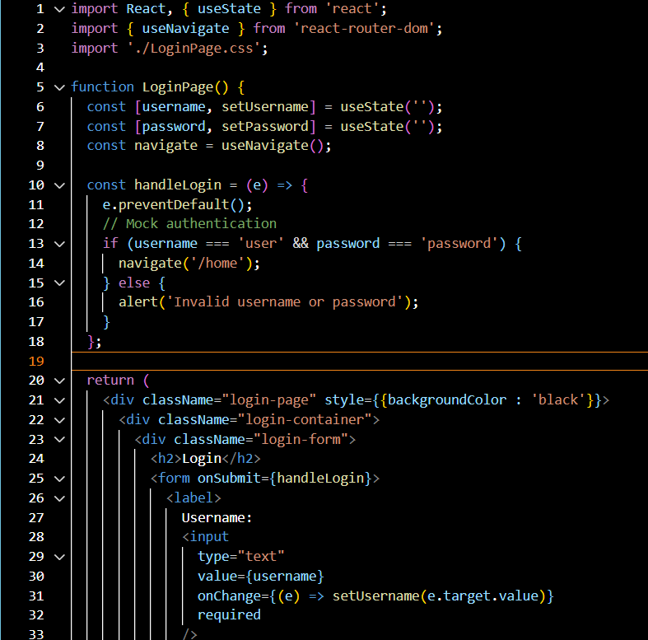
COMPONENTS USED:
2. LoginSelection.js:
Styles: Uses the styles available in LoginSelection.css to make the pages look attractive.
Work: Offers the user the option to choose their role (e.g., Guest, Admin) to proceed with the application.
Components Rendered: Navbar
useNavigate : A component that is used to navigate to different pages programmatically.
useState: A component that is used to maintain the state of the object in a functional component.

Slide 10
COMPONENTS USED:
3. LoginPage.js:
Styles: Uses the styles available in LoginPage.css to make the pages look attractive.
Work: Provides a secure login interface for application users, enabling them to book hotel rooms and provide feedback about the application.
Components Rendered: Navbar
useNavigate : A component that is used to navigate to different pages programmatically.
useState: A component that is used to maintain the state of the object in a functional component.

Slide 11
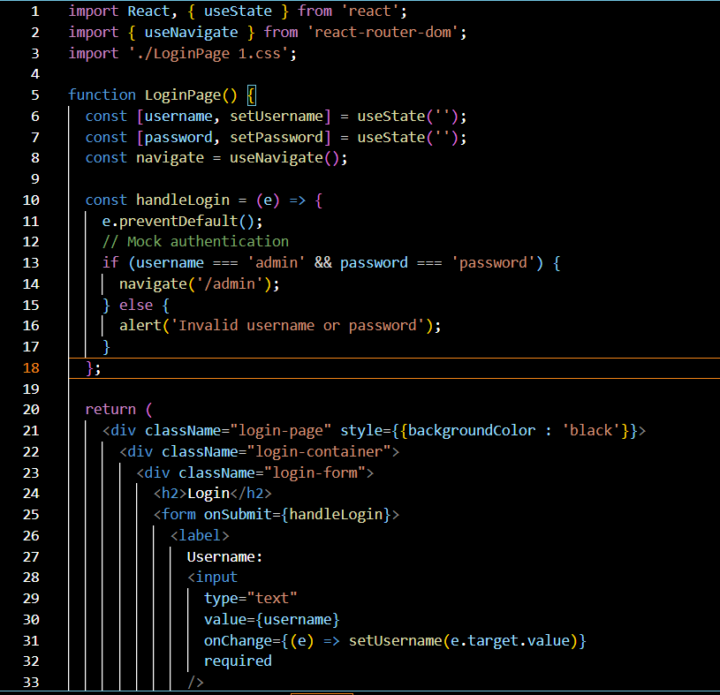
COMPONENTS USED:
4. LoginPage 1.js:
Styles: Uses the styles available in LoginPage 1.css to make the content look pleasing.
Work: Provides a secure login interface for application admins, enabling them to manage and supervise the application efficiently.
Components Rendered: Navbar
useNavigate : A component that is used to navigate to different pages programmatically.
useState: A component that is used to maintain the state of the object in a functional component.

Slide 12
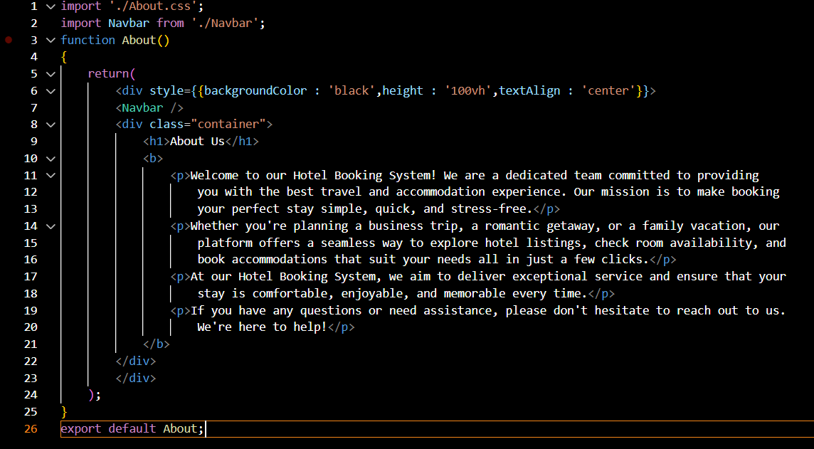
COMPONENTS USED:
5. About.js:
Styles: Uses the styles available in About.css to make the content pleasing and visually appealing
Work: Gives a description about the application, its specialties and motive of the application.
Components Rendered: Navbar

Slide 13
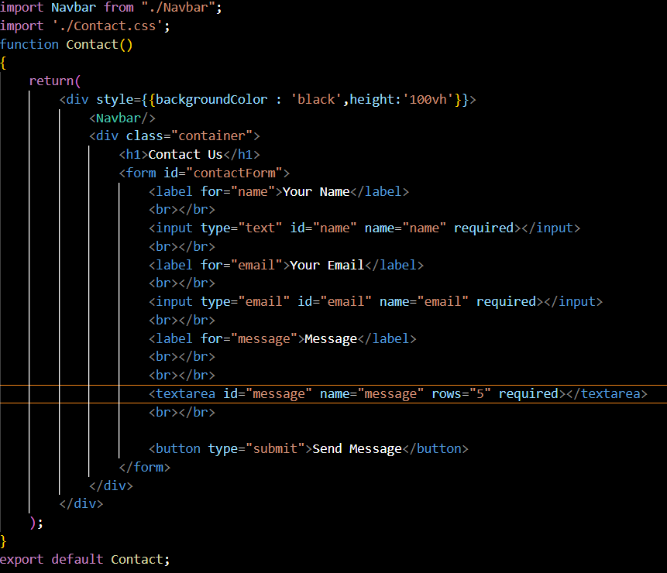
COMPONENTS USED:
6. Contact.js:
Styles: Uses the styles available in Contact.css to make the content attractive.
Work: Provides a form for the user to contact the admin of the application for any issues or grievances.
Components Rendered: Navbar

Slide 14
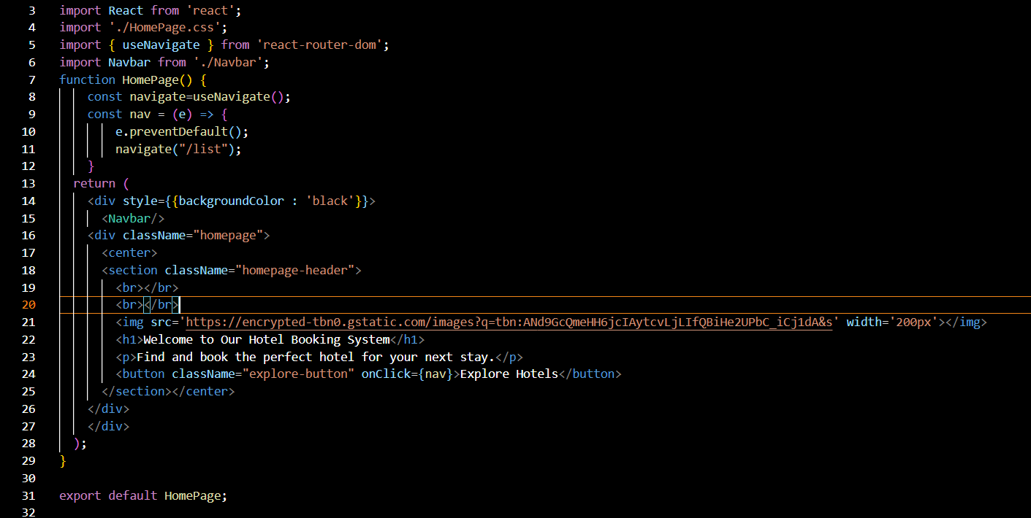
COMPONENTS USED:
7. HomePage.js:
Styles: Uses the styles available in HomePage.css to make the content aesthetic
Work: Provides a page to explore the application along with navigation bar.
Components Rendered: Navbar
useNavigate : A component that is used to navigate to different pages programmatically.

Slide 15
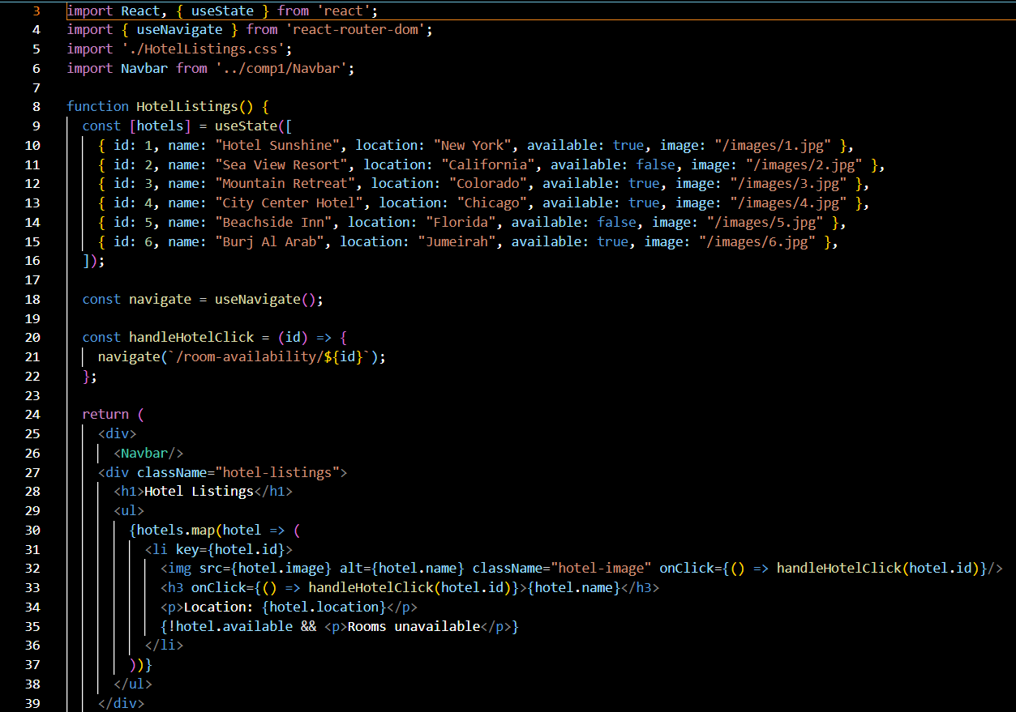
COMPONENTS USED:
8. HotelListings.js:
Styles: Uses the styles available in HotelListings.css to make the pages look aesthetic.
Work: Provides list of hotels for the users to book rooms along with the detail whether room is available in the hotel.
Components Rendered: Navbar
useNavigate : A component that is used to navigate to different pages programmatically.
useState: A component that is used to maintain the state of the object in a functional component.

Slide 16
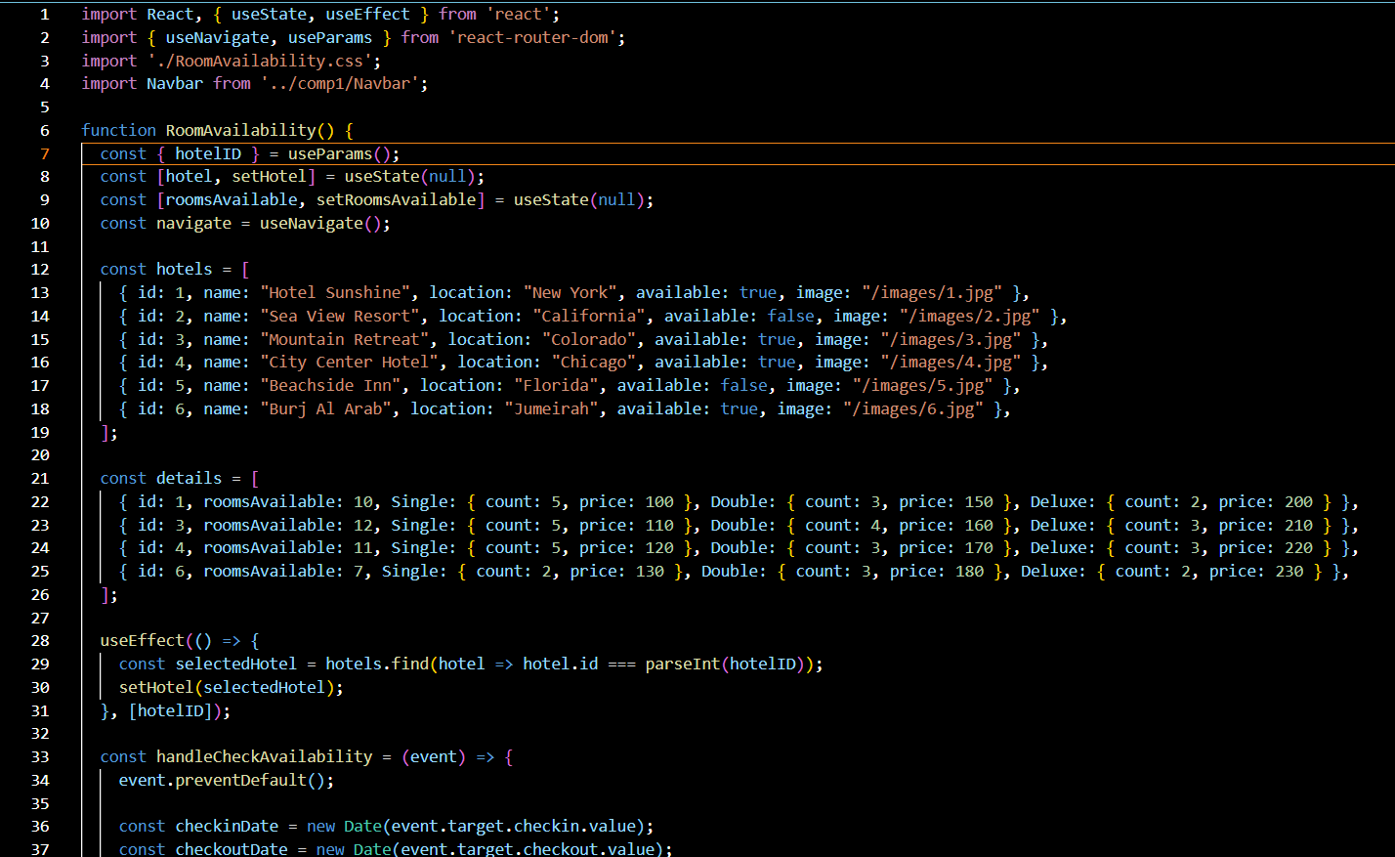
COMPONENTS USED:
9. RoomAvailability.js:
Styles: RoomAvailability.css
Work: Checks the room availability based on the check-in and check-out date.
Components Rendered: Navbar
useState: A hook that is used to maintain the state of the object in a functional component.
useNavigate : A hook that is used to navigate to different pages programmatically.
useEffect : A hook that is used to update the changes that is made in the state.
useParams : A hook that is used to access the parameters from the URLs.

Slide 17
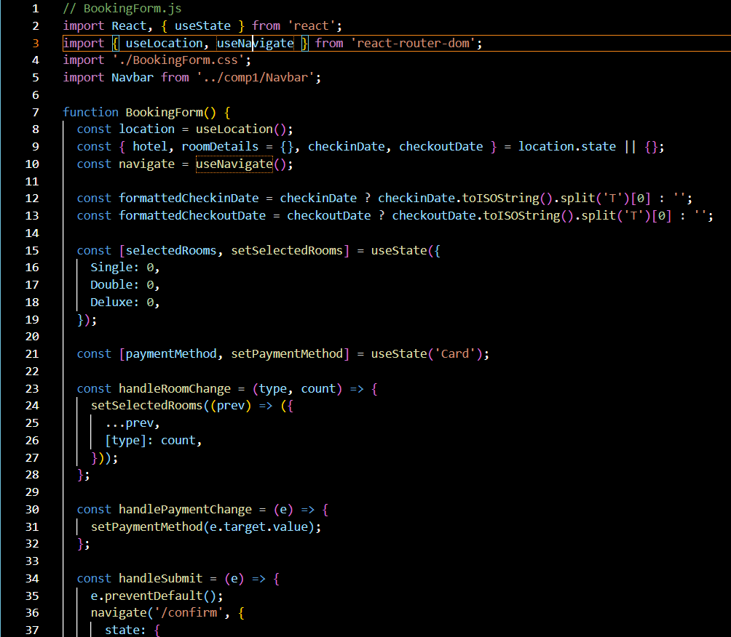
COMPONENTS USED:
10. BookingForm.js:
Styles: BookingForm.css
Work: Users select the room type (single, double or deluxe) and number of rooms required along with his personal details with payment method to proceed to confirmation.
Components Rendered: Navbar
useState: A hook that is used to maintain the state of the object in a functional component.
useNavigate : A hook that is used to navigate to different pages programmatically.
useLocation : A hook that is used to access the properties(here-state) of the current location(URL).

Slide 18
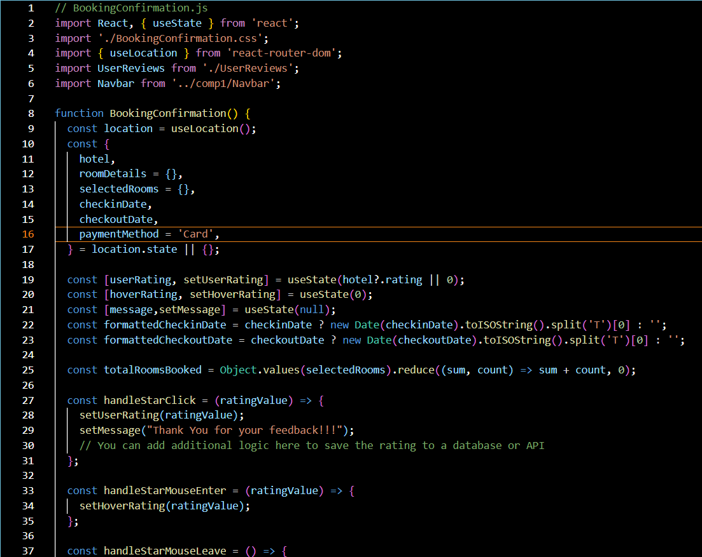
COMPONENTS USED:
11. BookingConfirmation.js:
Styles: BookingConfirmation.css
Work: Users can view the details of the room they have opted, confirm their booking and can provide feedback related to the hotel and application.
Components Rendered: Navbar, UserReviews
useState: A hook that is used to maintain the state of the object in a functional component.
useLocation : A hook that is used to access the properties(here-state) of the current location(URL).

Slide 19
COMPONENTS USED:
12. UserReview.js:
Styles: UserReview.css
Work: Contains a form to receive feedback from the user along with past feedbacks.
Components Rendered: Navbar useState: A hook that is used to maintain the state of the object in a functional component.
useLocation : A hook that is used to access the properties(here-state) of the current location(URL).

Slide 20
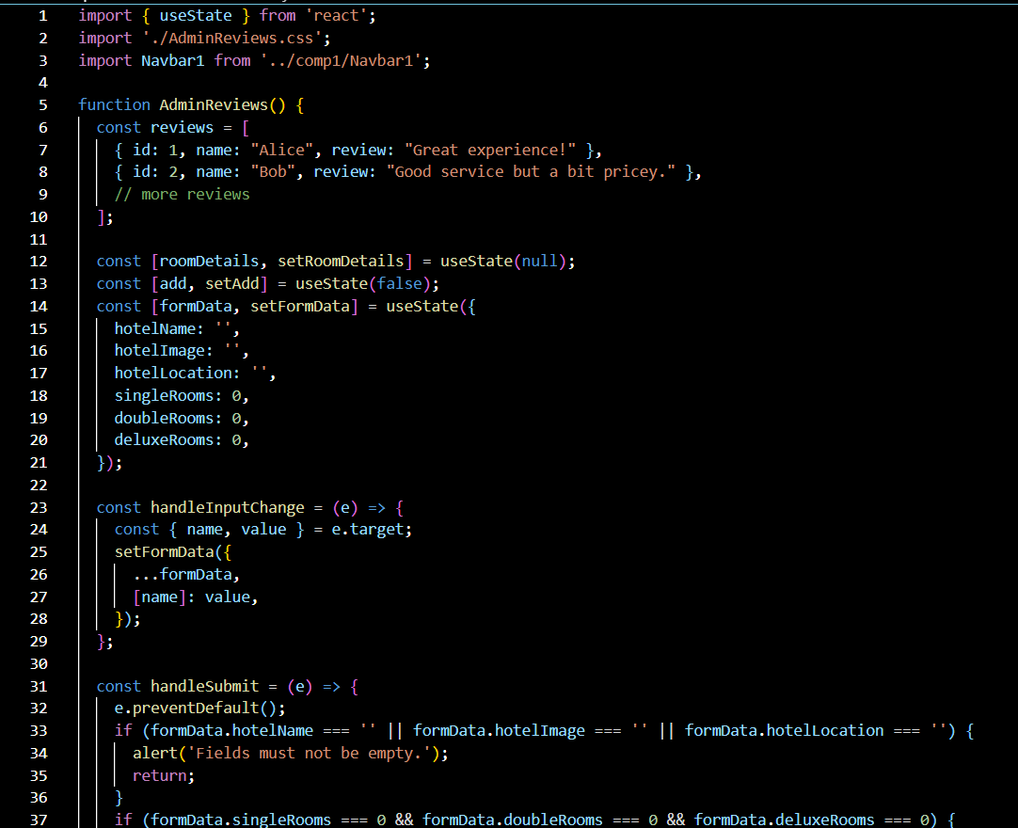
COMPONENTS USED:
13. AdminReview.js:
Styles: Uses the styles available in AdminReview.css to make the pages look attractive.
Work: Provides feedbacks given by the users about the hotels and application along with facility to add or update hotel details.
Components Rendered: Navbar
useState: A component that is used to maintain the state of the object in a functional component.

Slide 21
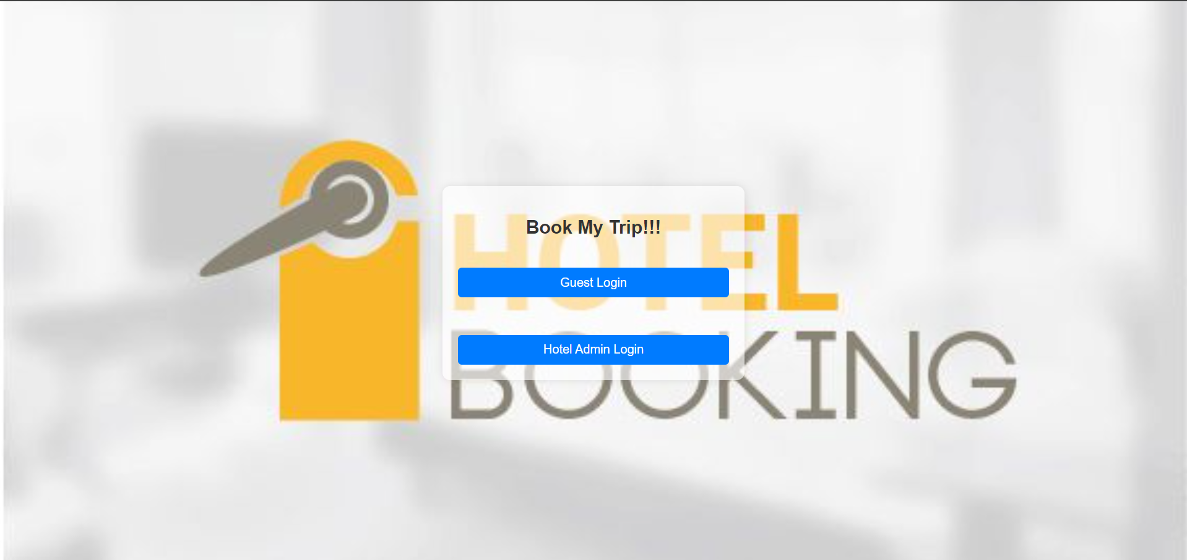
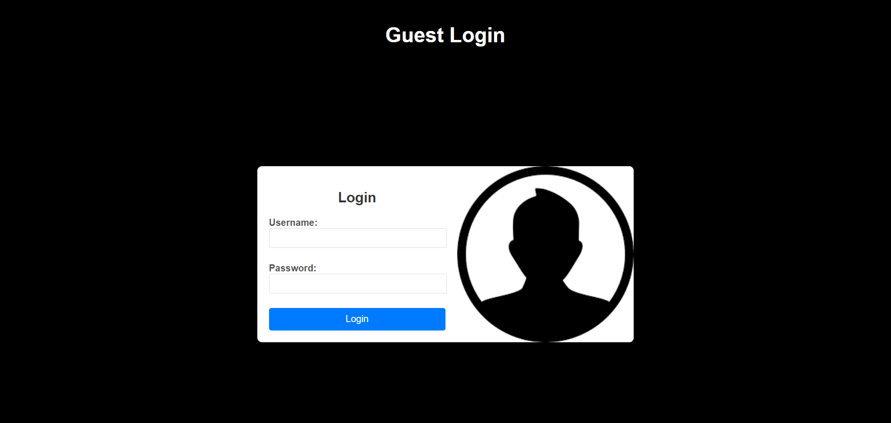
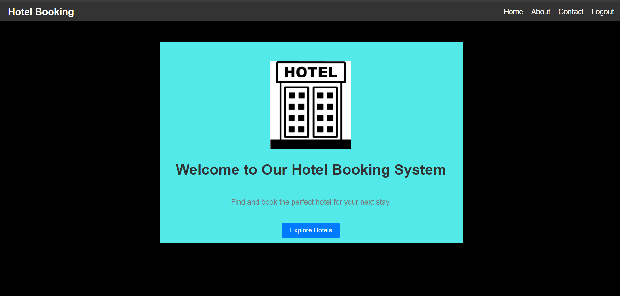
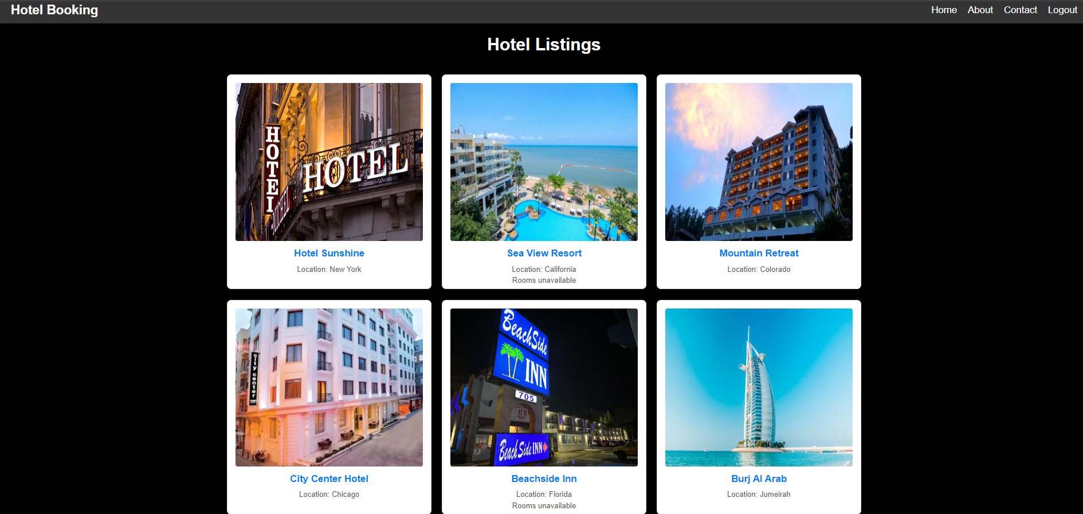
APPLICATION CAPTURES

Slide 22
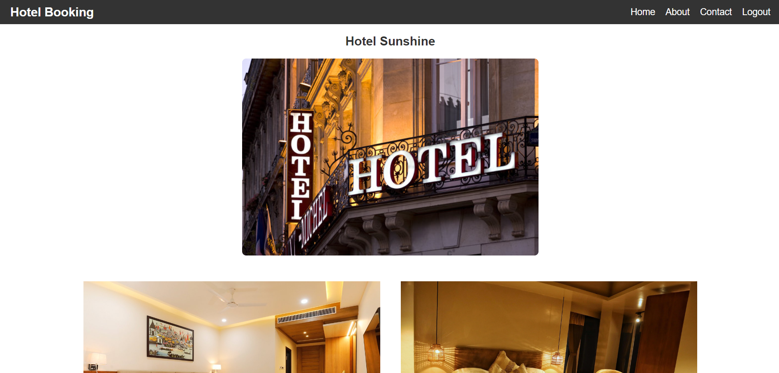
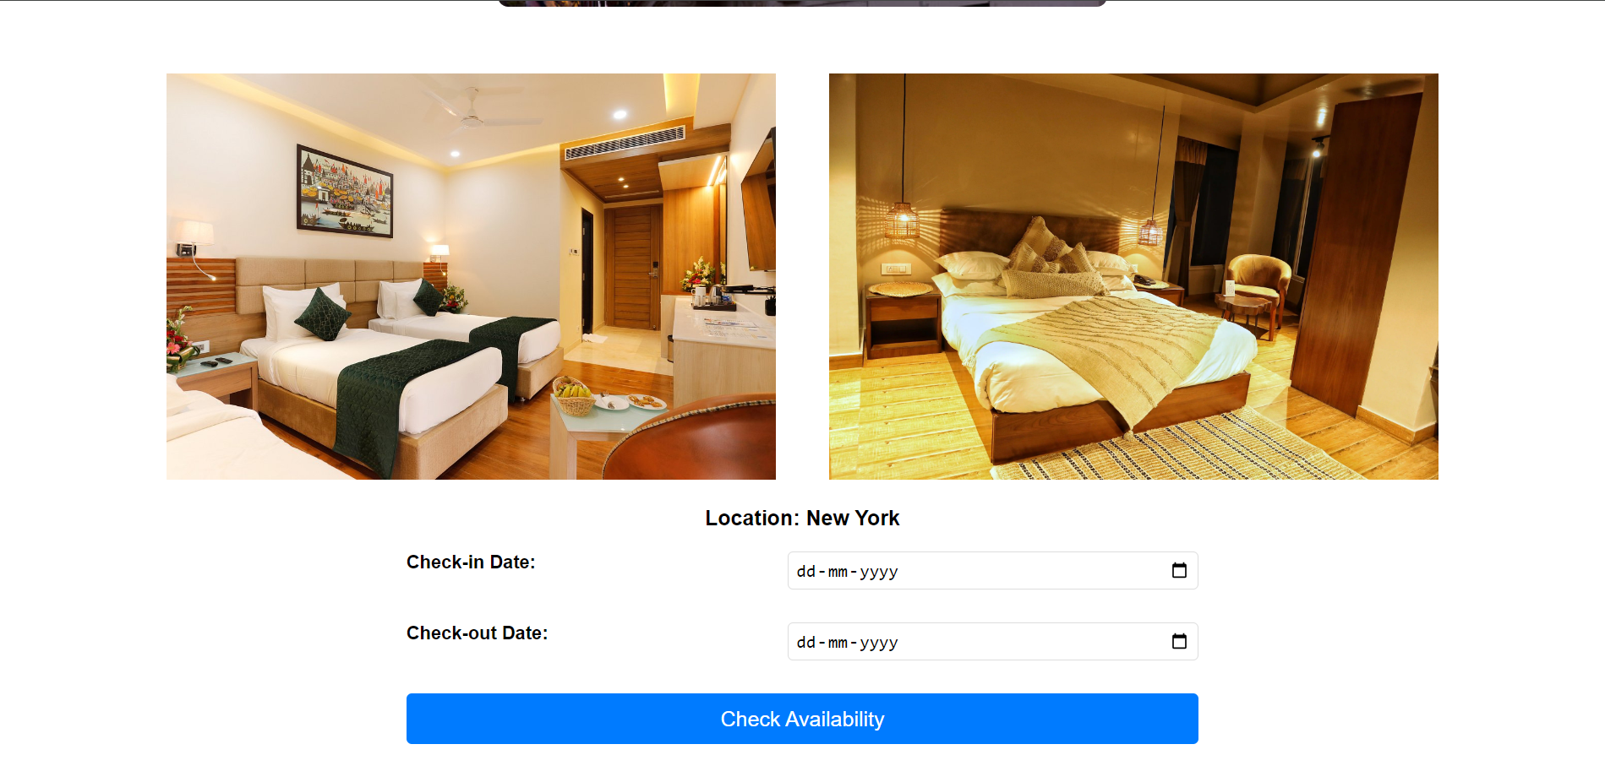
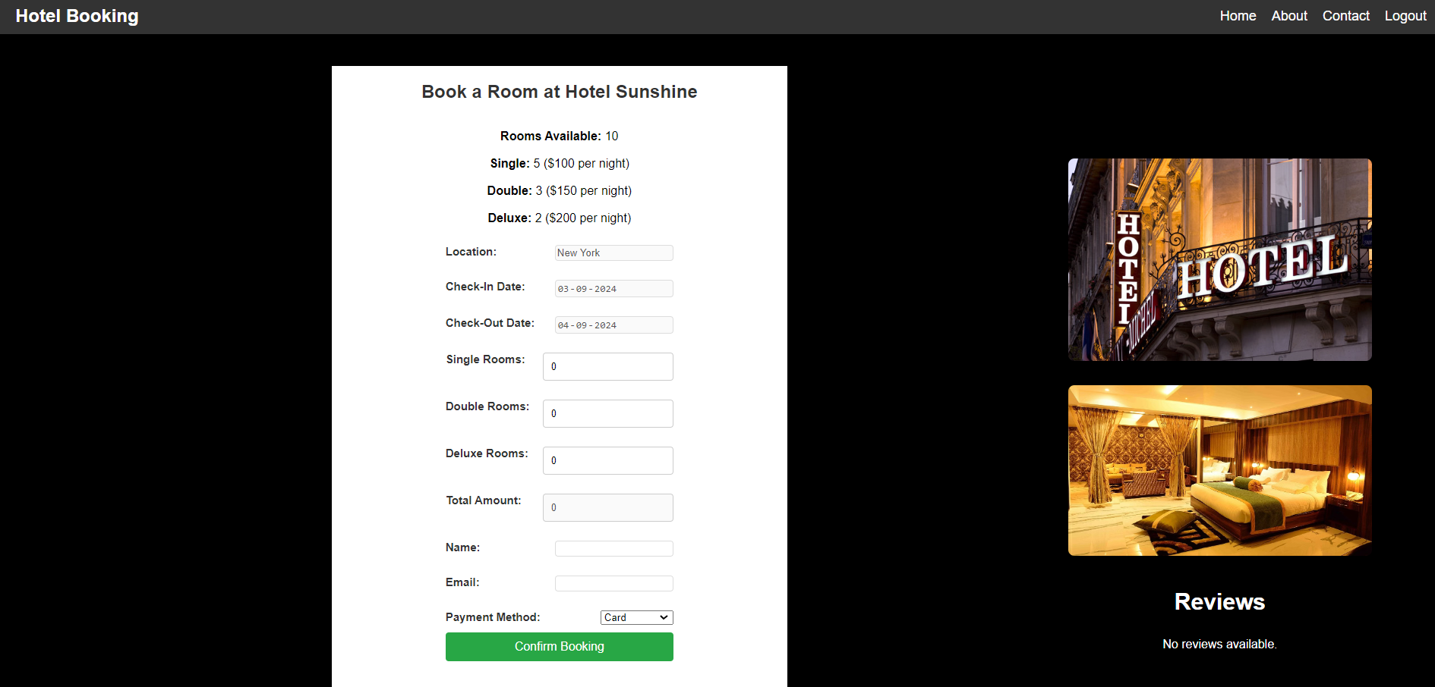
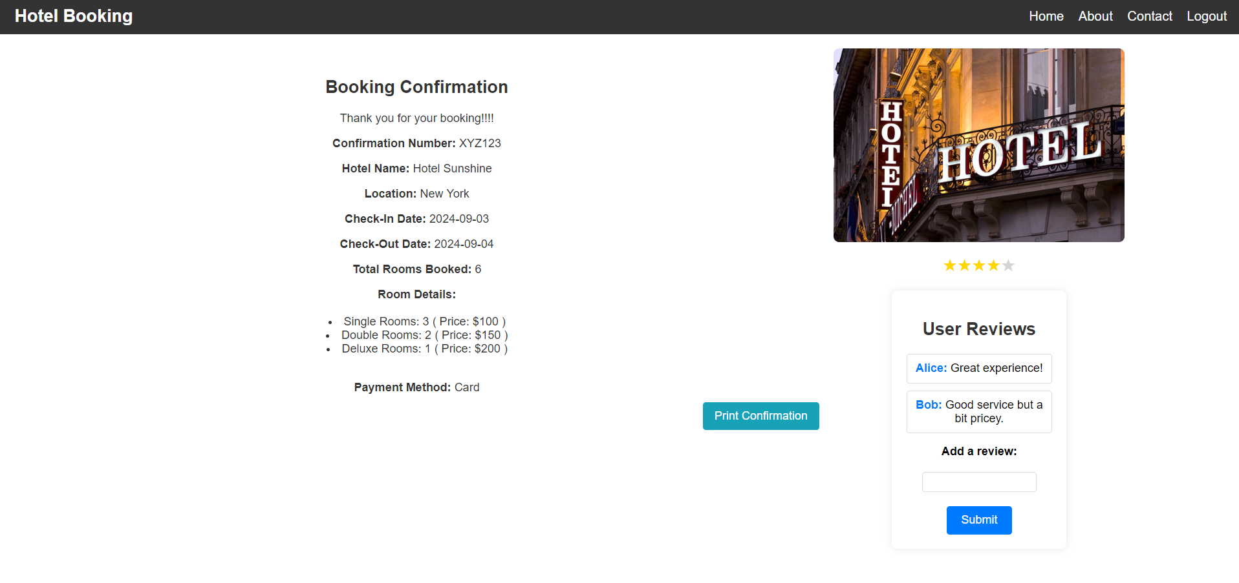
APPLICATION CAPTURES

Slide 23
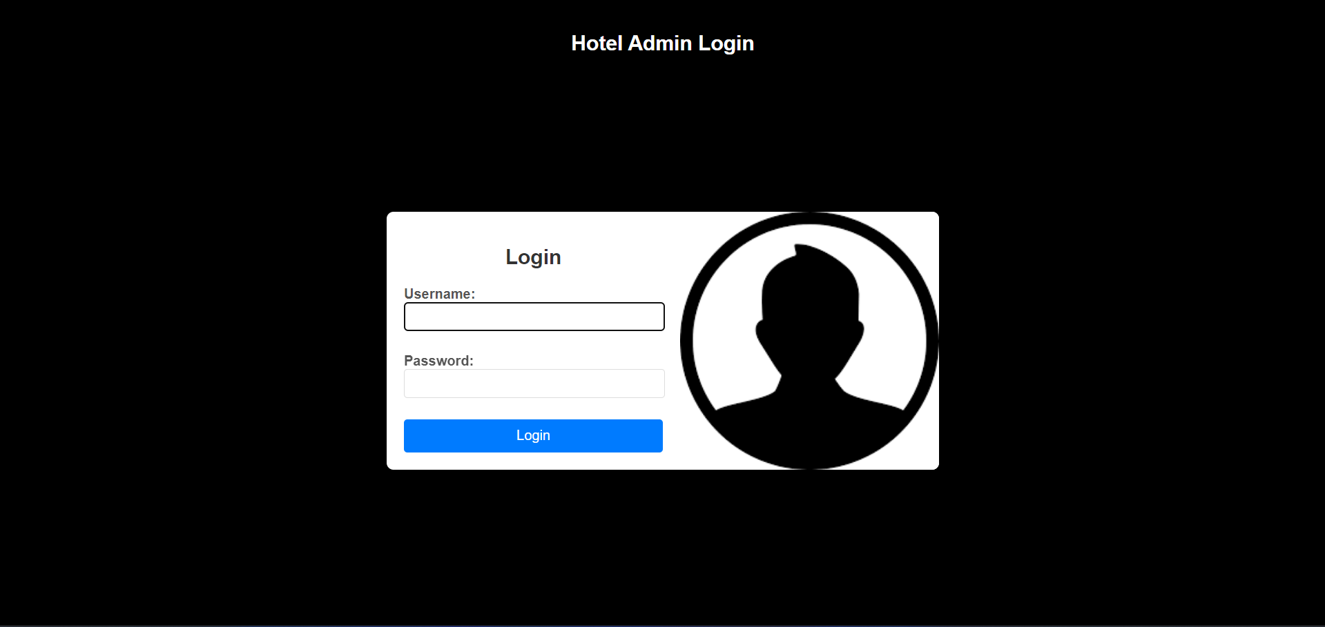
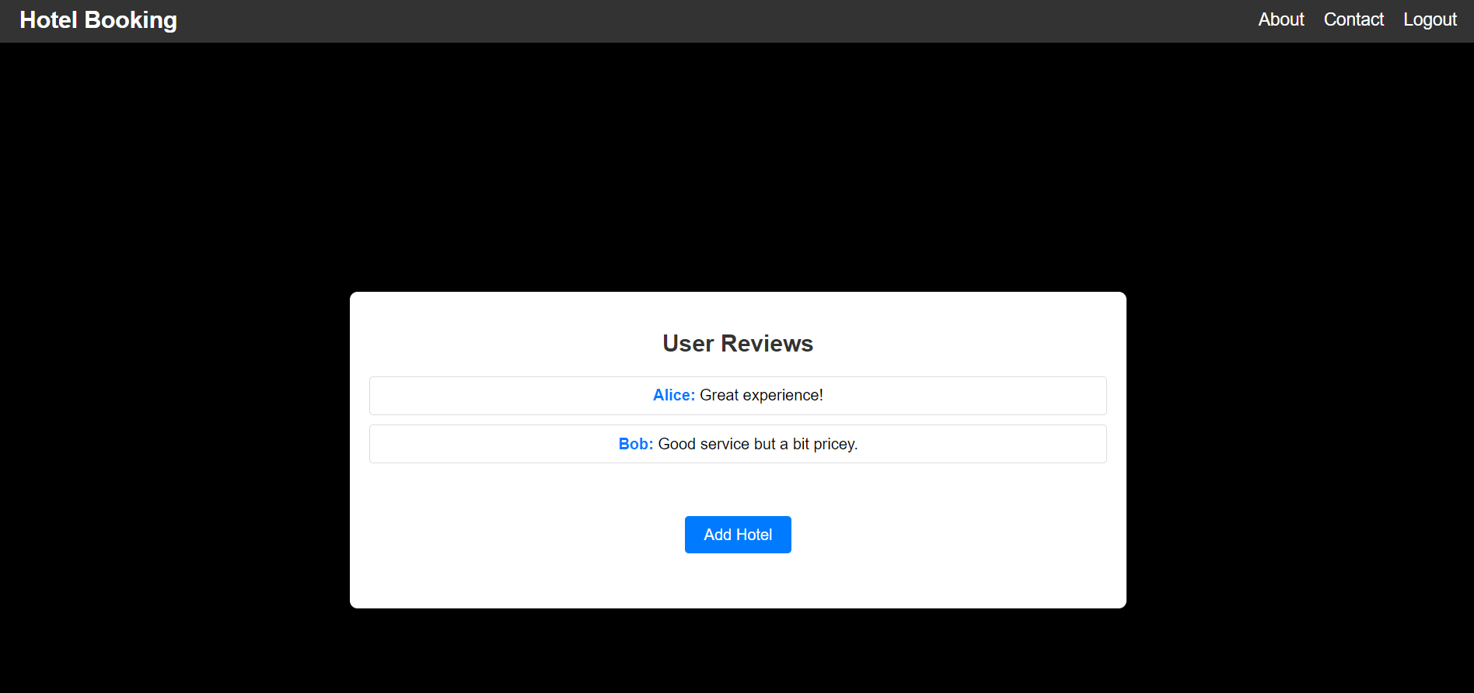
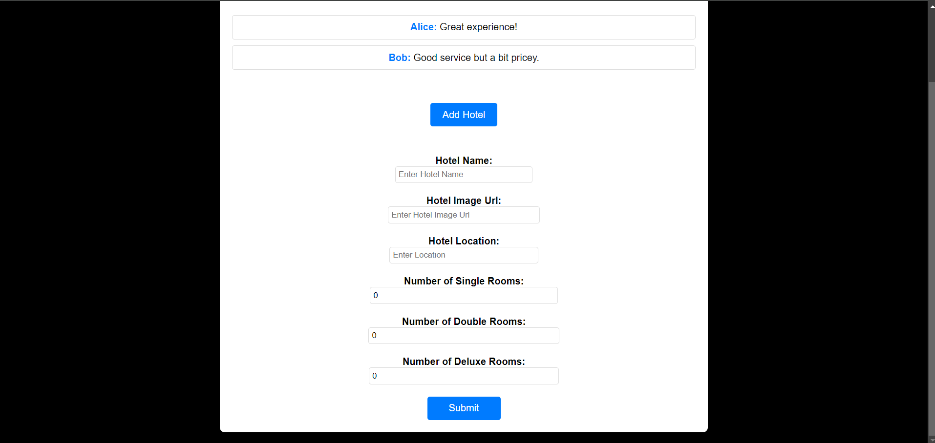
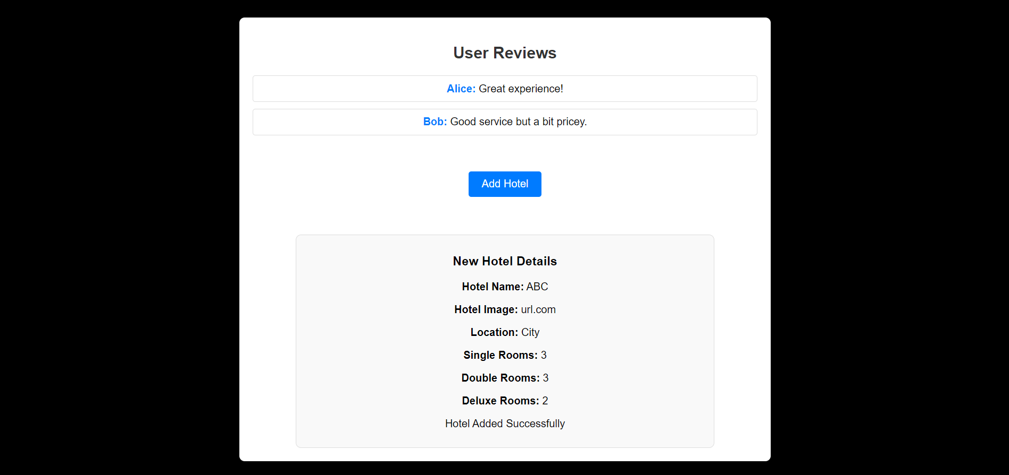
APPLICATION CAPTURES

Slide 24

FUTURE UPDATES:
Payment Processing
Backend connectivity with applications like MySQL
Deletion and manipulation of hotel details
Chatbot services

Slide 25


